Slide 1



SAP DOCUMENT AND REPORTING COMPLIANCE partner Solution
for Mexico E-Invoice Inbound
Enabling Sustainable Financial and Operating Success for Companies in USA/Brazil/LATAM/Europe/Asia

Slide 2


SAP DOCUMENT AND REPORTING COMPLIANCE partner Solution
for Mexico E-Invoice Inbound
January 2026

Slide 3








SAP Document and Reporting Compliance BACKGROUND
SAP Document and Reporting Compliance
SAP Document and Reporting Compliance framework has been developed by SAP Globalization Services
Facilitates realization of different local requirements
    by leveraging their similarities
    ensuring high standards
    consistent user experience and lower operational cost
    To comply with local regulations mandating the use of electronic documents to be sent to business partners and/or legal authorities.

Slide 4

SAP Document and Reporting Compliance
VALUE PROPOSITION
SAP Document and Reporting Compliance
SAP Document and Reporting Compliance is best suited for the exchange of electronic documents from SAP ERP & S/4 HANA due to its holistic, secure and integrated approach that helps companies stay compliant safely, globally and at affordable costs.

Slide 5

SAP Document and Reporting Compliance partner solution PREMISES
SAP Document and Reporting Compliance
SAP Document Compliance for Mexico Inbound is a Partner solution offered by Origen Tech that embraces SAP strategy and, leveraging the extensibility provided, it enables Supplier e-invoices for Mexico within SAP Document and Reporting Compliance framework. A building block to scale to one solution, one user experience and one business process worldwide.
Origen Tech have the capacity to provide on-going support for Customers adopting this solution.

Slide 6

INBOUND process in Mexico – What SAP DRC for Mexico Inbound supports
Enabling Sustainable Financial and Operating Success for Companies in USA/Brazil/LATAM/Europe/Asia

Slide 7
What SAP DRC for Mexico Inbound supports
Inbound XML storage
    Reception and persistence of supplier electronic invoice XMLs.
    Association with SAT identifiers (UUID, document type, issuer).
Inbound compliance status monitoring
    Validation of:
        SAT authorization.
        XML schema compliance and structure.
    Status tracking in the DRC monitor
Electronic receipt events (buyer responses)
    Generation and submission of:
        Acceptance or rejection of cancellation request.

Slide 8
What SAP DRC for Mexico Inbound supports
Audit and traceability
  Full trace of received document, events sent.
  Legal archiving (technical, not document management).
Inbound XML reception via: SAP BTP / Integration Suite from:
  SAT.
  Third-party provider.
Accounting posting handled by:
  SAP FI/MM processes (not yet available, in roadmap).
  External AP solutions (not yet available, in roadmap).
Perform business validations: Vendor, UUID and PO matching; Payment status and Payment Complement related; substitution; cancellation request).

Slide 9

INBOUND process in Mexico – SOLUTION OVERVIEW
Enabling Sustainable Financial and Operating Success for Companies in USA/Brazil/LATAM/Europe/Asia

Slide 10


INTEGRATION MONITOR WITH SAT - MEXICO
Flow of information and connections:
MONITOR DE IINTEGRATION MONITOR WITH SAT
VALIDATION AND REGISTRATION PROCESSES IN SAP

Slide 11



MEXICO INBOUND SOLUTION ARCHITECTURE
Transmitter
DIAN
SAT/PAC
SII
SAP Integration Suite (aka CPI)
Communication Platform
UBL 2.1
Webservice
DTE envelope
SAP ERP, option for eDocument/DRC processing
Suite
Colombia
Mexico
Chile
FI-AP

Slide 12
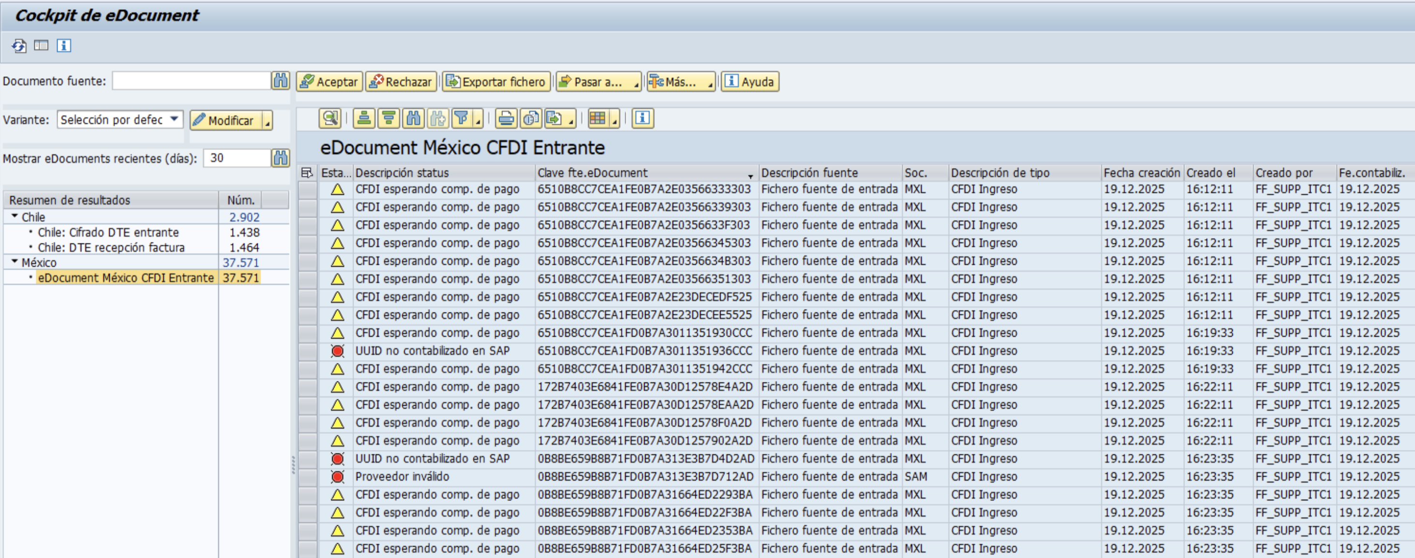
SAP Document and Reporting Compliance partner solution for Mexico Inbound COCKPIT
Transaction: edoc_cockpit
“Aceptar” / ”Rechazar” this action will only be available when the CFDI status is "Cancellation Request Received". The buttons will allow you to accept or reject the cancellation request.
“Pasar a” -> source Document, displays the CFDI received in XML format.
“Mas” -> start Inbound Automation, this action triggers the execution of the corresponding rules to perform validations on each document and assign the appropriate status for each scenario. This action will be configured as automatic in a job but can always be executed manually if needed.

Slide 13
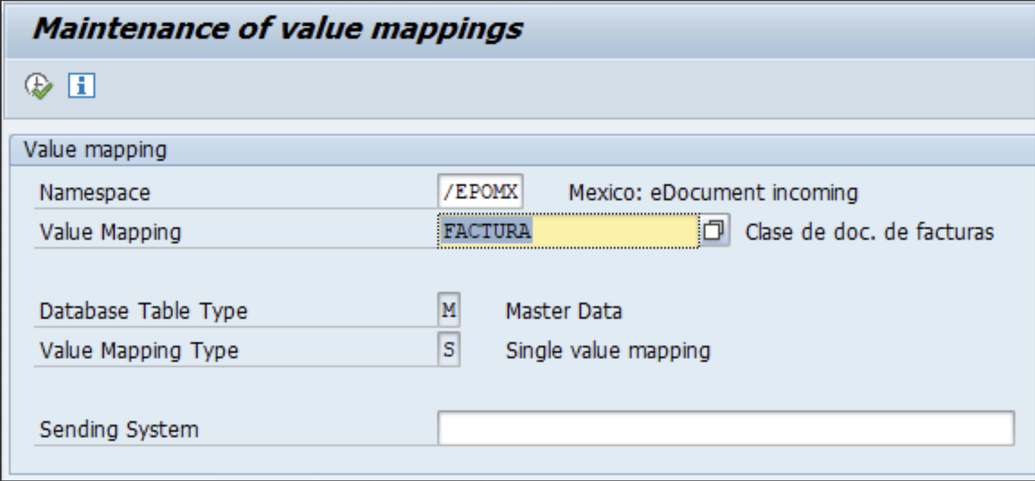
SAP PARTNER NAME SPACE
N/AIF/VMAP
Technical objects, configuration for e-invoice inbound functionality for Mexico and to map governments’ catalogs to SAP’s data are registered and stored in SAP partner namespace

Slide 14
Available scenarios for Origen partner solutions
VIETNAM
ARGENTINA
PANAMA
ECUADOR
PARAGUAY
Customer Invoice
Customer Invoice
Customer Invoice
Customer Invoice
Customer Invoice
Credit & Debit Note
Credit & Debit Note
Credit & Debit Note
Credit & Debit Note
Self-Billing
Settlement of purchase of goods and provision of services.
Trade Discount
Export Invoice
Export Invoice
Debit and Credit Note
E-Delivery Note
Credit Invoice (MiPyME)
Zona Franca Invoice
E-Delivery note
Delivery Note
Supplementary Invoice
Export Credit & Debit Note
Purchase Withholding
Certificate

Slide 15


The “Best in Class” SAP ecosystem partner providing strategic end-to-end SAP consulting services.
MAIN OFFICE
801 Brickell Avenue - 8th Floor
Miami, Florida 33131
NORTH AMERICA OFFICE
9600 Escarpment Blvd. Suite 745-36
Austin, Texas 78749
ARGENTINA OFFICE
Libertador Avenue 101 10th Floor, (B1638BEA)
Vicente Lopez
Buenos Aires – Argentina
CHILE OFFICE
Av Providencia, 1208
Oficina 207, RM,
Postal Code 75000000
Santiago de Chile
CARIBBEAN OFFICE
Metro Office Park
Building 7
Postal Code 00968
Guaynabo -PR
MEXICO CITY OFFICE
Park Palza – Av. Javier Barros Sierra, 540 Torre 1 Piso 5 – zip code 01210
Santa Fe, Mexico City
MONTERREY OFFICE
Calle Virgilio Graza, No. 209
Monterrey, Nuevo
Leon - Mexico
BRAZIL OFFICE
Avenida das Nações Unidas, 14171, 15º andar
Morumbi
CEP 04794-000
São Paulo/SP - Brazil

