Slide 1



Corporate overview
Building Bridges
Between Global Technology and Local Expertise

Slide 2






Founded on specialization
About Origen Tech
Origen Tech is distinguished as a “Best in Class” SAP Global Partner Origen Tech is well recognized in the industry, for its extensive SAP ERP experience and capability , as well a deep localization expertise in the areas of SAP S/4HANA RISE, Document and Reporting Compliance, Global Trade Services. It is also a product development and service partner for TAX and Localization , with offices in US, Brazil, Mexico, Argentina, Chile and the Caribbean, and a portfolio of more than 100 Multinational clients. Founded in 2012 in the USA, Origen Tech is a VAR Partner, Service, Solution and Co-innovation SAP Partner committed to help customers find process-based solution.
Empowering global enterprises
Extensive SAP ERP experience
Strong alliance & partnerships
Deep localization expertise across US, LATAM & Brazil
Risk and compliance solution DRC/GTS
1000+ SAP resources serving over 150+ clients
15+ years

Slide 3

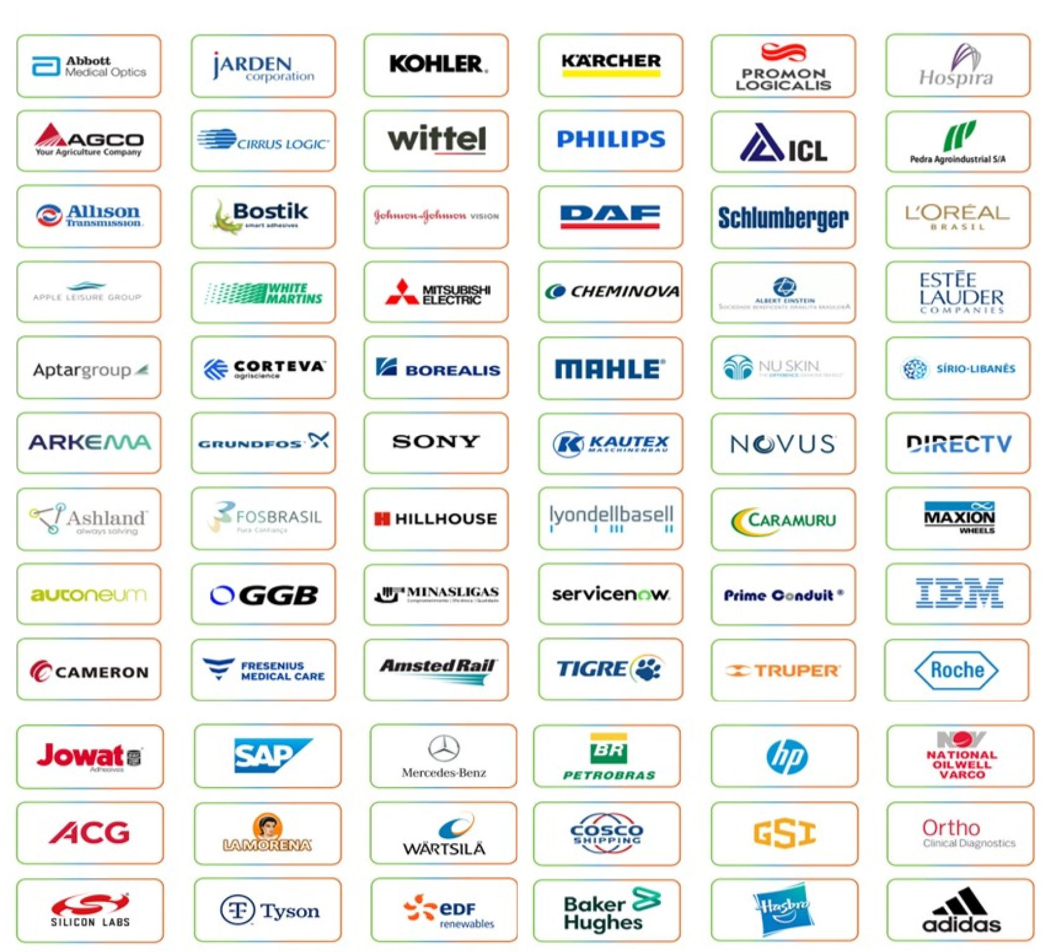


Trusted by Industry Leaders
Our customers
Why Origen Tech
We deliver end-to-end solutions and services
More than a supplier, we are your strategic business partner
We are flexible and adapt to your business reality
We have global expertise with multicultural teams
We deliver local projects with global template standards
We meet all your local fiscal and tax requirements
Innovation and commitment are in our DNA

Slide 4


Our services
Origen Tech Offerings
Managed Service​
S/4 HANA
SOLaaS
AMS
Compliance Solutions
Shared Service​
AI Digital Optimization

Slide 5



Our services
SAP DRC Expertise
Development partner for SAP LATAM/Central America/Caribbean
Lead GTM Partner for SAP DRC​ Electronic Invoicing Solutions​
Preferred Partner -CCH® SureTax​ By Wolters Kluwer​
Partnership with Synchro- Brazil​ Largest fiscal solutions provider​ Integration with SAP DRC and Synchro​
100+ Strong DEVOPS team​ For Product Development and Innovations​
100+ Countries need E- Document Submissions to Government ​

Slide 6
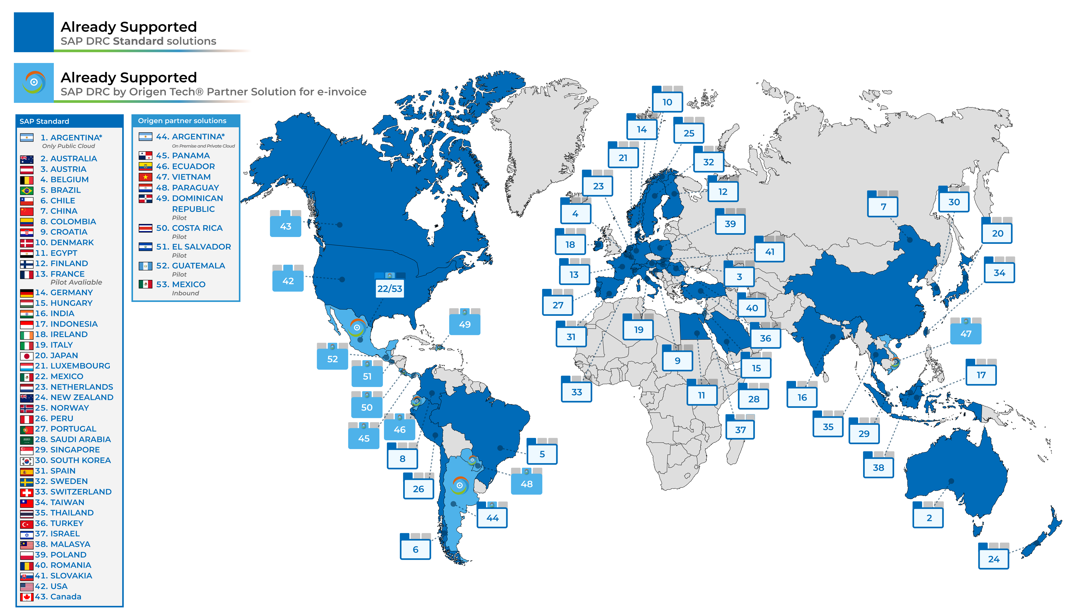
Our Services
SAP Document and Reporting Compliance
A development partner for SAP in Latin America, Central America, the Caribbean and Asia
Lead GTM Partner for SAP DRC​ Electronic Invoicing Solutions​
Partnership with Synchro (Brazil), the largest fiscal solutions provider, delivering integration with SAP DRC and Synchro
100+ Strong DEVOPS team​ For Product Development and Innovation​
100+ countries requiring electronic document submissions to governments
Our extensive and unique IP across several countries allows ours Multinational Clients to adopt SAP Tax & Trade standard SAP Platforms to run globally

Slide 7
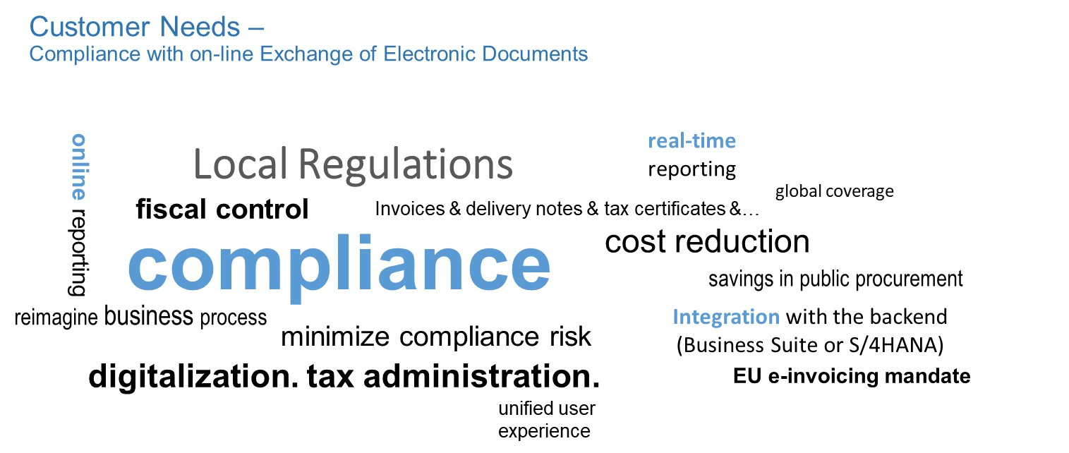

Electronic Invoice for Argentina as part of SAP Document & Reporting Compliance

Slide 8










SAP Document and Reporting Compliance – Background
SAP Document & Reporting Compliance
eDocument framework has been developed by SAP Globalization Services
Facilitates realization of different local requirements
To comply with local regulations mandating the use of electronic documents to be sent to business partners and/or legal authorities
By leveraging their similarities
Ensuring high standards
Consistent user experience and lower operational cost

Slide 9

SAP Document and Reporting Compliance – Value Proposition
SAP Document & Reporting Compliance
SAP Document and Reporting Compliance is best suited for the exchange of electronic documents from SAP ERP & S/4 HANA due to its holistic, secure and integrated approach that helps companies stay compliant safely, globally and at affordable costs.

Slide 10
SAP Document and Reporting Compliance – Partner Solution Premises
SAP Document & Reporting Compliance
SAP Document Compliance for Argentina e-invoice is embracing SAP strategy and, leveraging the extensibility provided, it enables e-invoices for Argentina within SAP Document and Reporting Compliance. A building block to scale to one solution, one user experience and one business process worldwide.
Solution is available and published in the SAP Store.
Origen Tech provide legal updates to the solution in the case of legislative changes as mandated by Argentina government/ARCA tax authority.
Origen Tech have the capacity to provide on-going support for Customers adopting this solution.

Slide 11
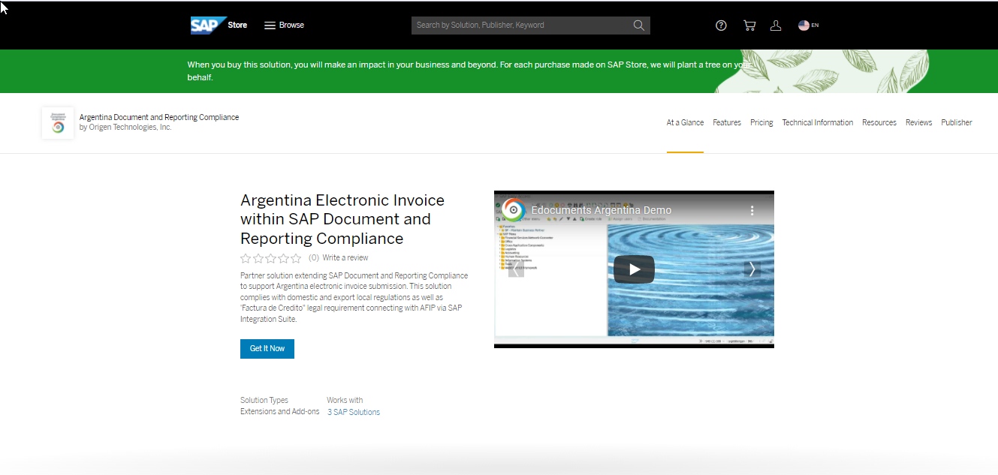
SAP Document and Reporting Compliance for Argentina in SAP Store
Notes:
https://store.sap.com/dcp/en/product/display-0000060210_live_v1/Argentina%20Document%20Compliance

Slide 12

SAP Document and Reporting Compliance for Argentina
Regulatory Background for electronic invoicing

Slide 13
Legal Requirement
This solution for e-invoice is divided in three parts (RG4291, RG2904 and RG2758), which are different resolutions from ARCA:
RG4291 (aka 2485) solution supports the national legal requirement ARCA Resolución General 2485/2010. Every official document with print character A and B must contain a CAE number (Comprobantes Electrónicos Emitidos) and ODN (Official Document Number) before sending to customers. RG2485 solution is only valid for domestic scenarios of sales in Argentina, it sends document header information to ARCA.
RG2758 solution supports the national legal requirement ARCA Resolución General 2758/2011. Every official document with print character E of export sales must contain a CAE number (Comprobantes Electrónicos Emitidos) and ODN (Official Document Number) before sending to customers. RG2758 solution is only valid for export sales in Argentina.
RG2904 solution supports the national legal requirement ARCA Resolución General 2904/2010. Every official document with print character A and B must contain a CAE number (Comprobantes Electrónicos Emitidos) and ODN (Official Document Number) before sending to customers. RG2904 solution is only used for domestic scenario of sales in Argentina, it sends document header and line-item information to ARCA.
The communication on the solution happens between SAP ERP or S/4 and ARCA website via SAP Cloud platform. Documents are sent to ARCA for CAE approval and their approval from ARCA return to SAP.

Slide 14
New Regulation Electronic credit invoice MiPyMes (FCE)
The MiPyMes Electronic Credit Invoice (FCE) becomes mandatory in Argentina with the aim of promoting the financing of micro, small and medium-sized businesses.
ARCA has launched the MiPyMes Electronic Credit Invoice Regime, as set forth in resolution 5/2019, from May 1, to September 2019 on which different industrial segments have been gradually joining the scheme.
Use of the FCE is indicated for invoices type A, B and C, with their respective credit and debit notes.
Whether you are a receiver or an issuer, you must have the Electronic Tax Domicile set up.
In addition, issuers of electronic credit invoicing must register a CBU, which is where the amount discounted from the invoice will be deposited.
If a supplier issues a bill to a large company and states in the invoice that the payment is to be made by credit, the supplier may choose between issuing an electronic credit invoice (FCE) in order to cash in the invoice in advance through the electronic Tax Domicile portal or wait until the company pays up.
SAP solution can connect with the ARCA and to integrate the FCE information into the ERP or S/4 and, likewise, integrate the invoice.

Slide 15


SCOPE
The generation of the e-Invoices and e-Credit Memos is based on the invoices and credit memos documents saved.
Invoices and Credit Memos documents.
(Examples of transactions:
VF01, VF04, FB70, FB75).
New record is created in the eDocument Cockpit per invoice or credit memo document saved.
An e-Invoice / e-Credit memo generated per record.

Slide 16

SAP Document and reporting Compliance
for Argentina
Solution Overview

Slide 17

SAP Document and Reporting Compliance
Scenarios for Latin America
PERU
CHILE
COLOMBIA
ARGENTINA
MEXICO
Customer Invoice
Customer Invoice
(DTE eInvoice)
Customer Invoice
Customer Invoice
Payment Complement
Consumer invoice
(Boleta)
Vendor Invoice
(DTE eInvoice)
Vendor Invoice
Customer Credit Invoice (FCE MyPymes)
Customer Invoice
Withholding Tax Certificate
Delivery Note
Foreign trade Complement
Tax Collection
Certificate
Consumer Invoice
(Boleta)
Addenda and Pedimento
Ledgers
© 2023 SAP SE or an SAP affiliate company. All rights reserved I CUSTOMER.

Slide 18

Solution Architecture
Suite
Legal Reports
SD Del GI
FI-AR
SD Bill
IS-U
Real Estate
SAP ERP option for eDocument processing
Chile
Peru
Argentina
Mexico
Netherlands
Belgium
Communication Platform
SAP Integration Suite
SCP Service *
DTE
UBL
Webservice
CFDI
EU-UBL
Recipient
SII
SUNAT
ARCA
PAC
Business Partner
* Provider (SAP) managed

Slide 19

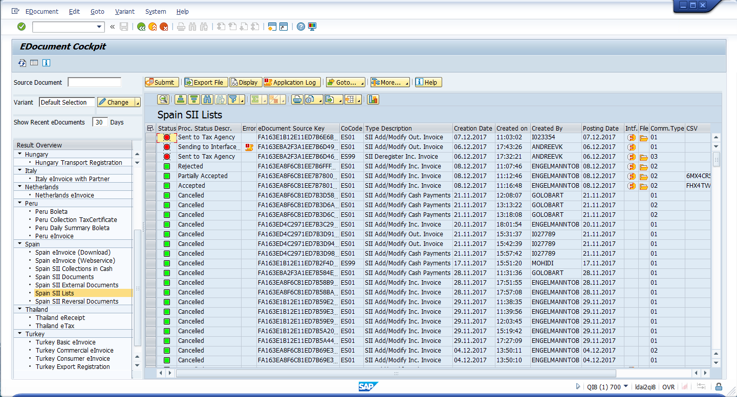
SAP Document and Reporting Compliance Cockpit – key product features
View / Export file
Information about the selected process
Submit / Resubmit
Further country-specific* capabilities:
Generic information about the Cockpit
- Switch to contingency
- Import data from non-SAP systems
- Send to customer
- Accept/Reject
- Cancel/Delete
Selection variants including filter by source data
Central monitor for all scenarios
Only authorized processes are displayed
Navigate to interface monitor
Batch & List handling
PDF generation (XML-based)
Display eDocument history Application Log
Navigate back to source document

Slide 20

The “Best in Class” SAP ecosystem partner providing strategic end-to-end SAP consulting services.
MAIN OFFICE
801 Brickell Avenue - 8th Floor
Miami, Florida 33131
NORTH AMERICA OFFICE
9600 Escarpment Blvd. Suite 745-36
Austin, Texas 78749
ARGENTINA OFFICE
Libertador Avenue 101 10th Floor, (B1638BEA)
Vicente Lopez
Buenos Aires – Argentina
CHILE OFFICE
Av Providencia, 1208
Oficina 207, RM,
Postal Code 75000000
Santiago de Chile
CARIBBEAN OFFICE
Metro Office Park
Building 7
Postal Code 00968
Guaynabo -PR
MEXICO OFFICE #1
Park Palza – Av. Javier Barros Sierra, 540 Torre 1 Piso 5 – zip code 01210
Santa Fe, México City
MEXICO OFFICE #2
Calle Virgilio Garza, No. 209
Monterrey, Nuevo
León - México
BRAZIL OFFICE
Avenida das Nações Unidas, 14171, 15º andar
Morumbi
CEP 04794-000
São Paulo/SP - Brasil

