Slide 1





Origen Tech is well recognized in the industry for its extensive global SAP ERP experience and deep localization expertise across SAP S/4HANA RISE, SAP Document and Reporting Compliance, and SAP Global Trade Services.
We have offices in the U.S., Brazil, Mexico, Argentina, Chile, and the Caribbean, supporting more than 150 multinational clients with their projects in the Americas, Europe and Asia. Founded in 2012 in the USA, Origen Tech is an SAP Gold VAR Partner, Service Partner, Solution Partner, and Co-innovation Partner committed to helping customers implement efficient, process-based solutions.
Building Bridges
Between Global Technology and Local Expertise
Empowering global enterprises - Strong alliance & partnerships - Risk and compliance solutions SAP DRC & SAP GTS - Extensive SAP ERP experience

Slide 2

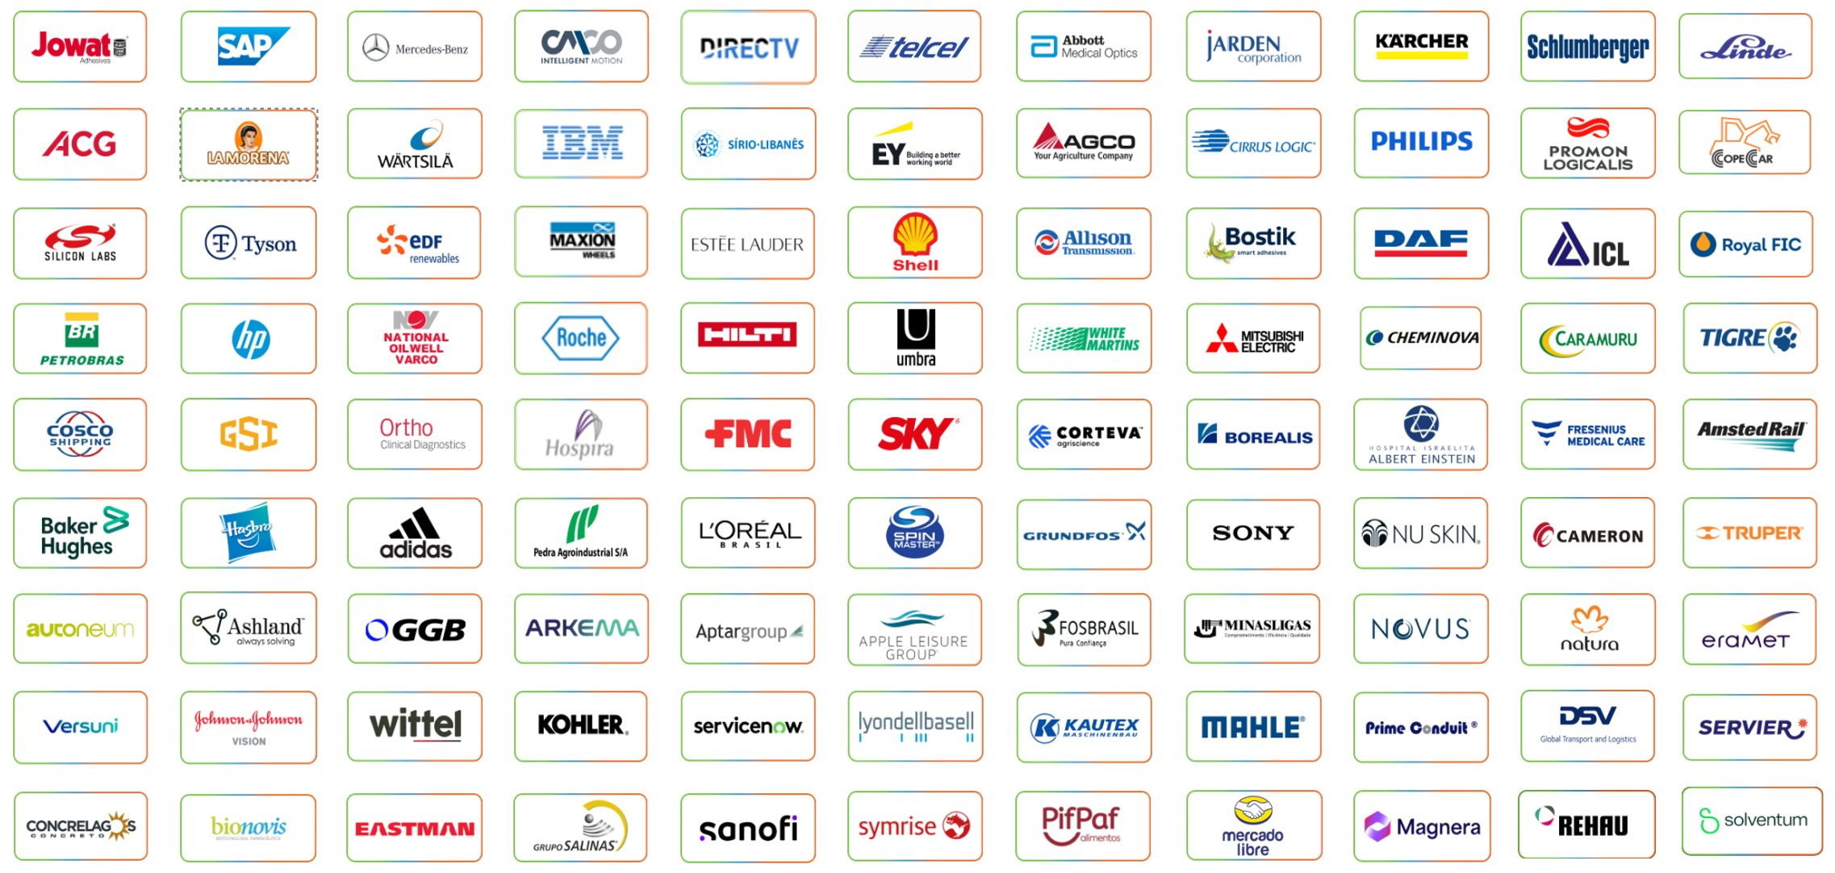
Who trusts Origen Tech
We bring global expertise with multicultural teams - We deliver local projects using global template standards - We meet all your local fiscal and tax requirements - Innovation and commitment are in our DNA

Slide 3
SAP Document and Reporting Compliance
One Globalization Network
Professional processes and services
Key Pain Points + Solution Points
Solution integrated with the backend (ECC/S4HANA)
Ineffective Support
High effort for synchronization of legal changes
Multiple counterparts
Lack of process expertise from EDI service provider
Data Inconsistency
Adjustments done on 3rd party software not reflected in backend
Total Cost of Operations
Multiple solutions to be implemented and supported
Multiple contract partners
Usability
Multiple monitors, configuration
and processes
One Solution
End-to-End approach
Unified user experience
Reduced set of tools

Slide 4

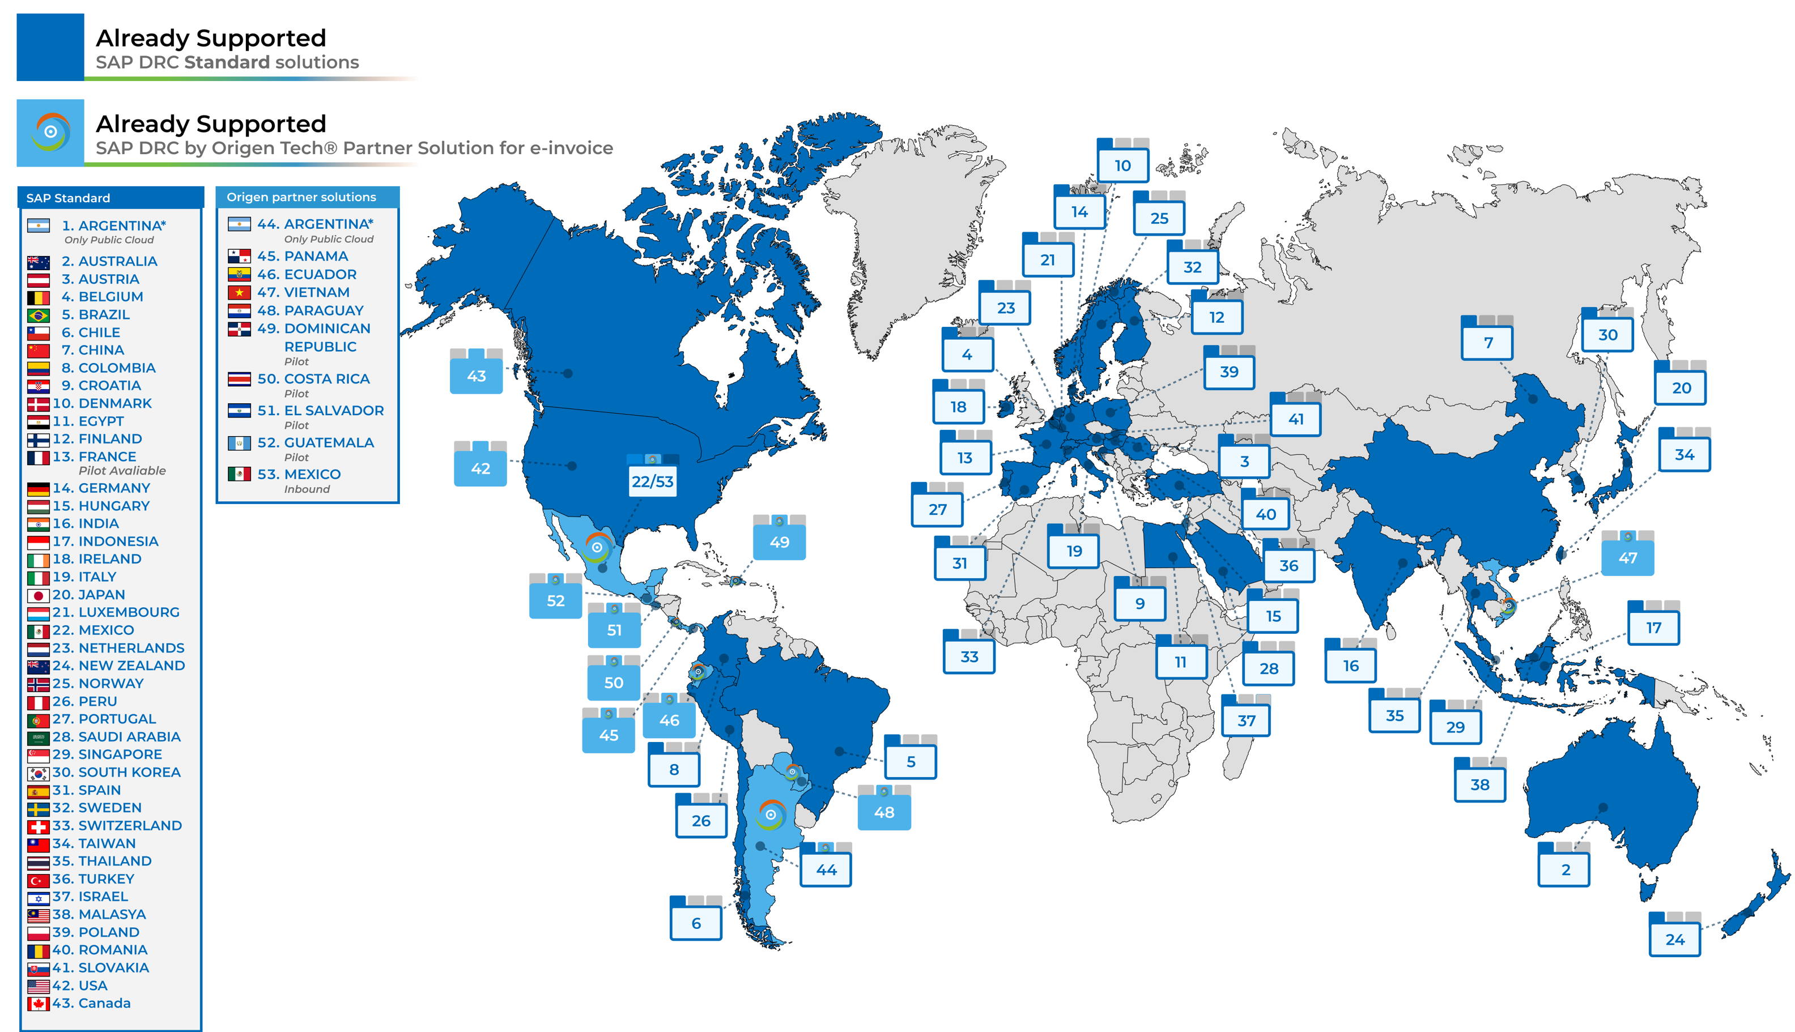

Our Services
SAP Document and Reporting Compliance
A development partner for SAP in Latin America, Central America, the Caribbean and Asia
Lead GTM Partner for SAP DRC​ Electronic Invoicing Solutions​
Partnership with Synchro (Brazil), the largest fiscal solutions provider, delivering integration with SAP DRC and Synchro
100+ Strong DEVOPS team​ For Product Development and Innovation​
100+ countries requiring electronic document submissions to governments
Our extensive and unique IP across several countries allows ours Multinational Clients to adopt SAP Tax & Trade standard SAP Platforms to run globally

Slide 5
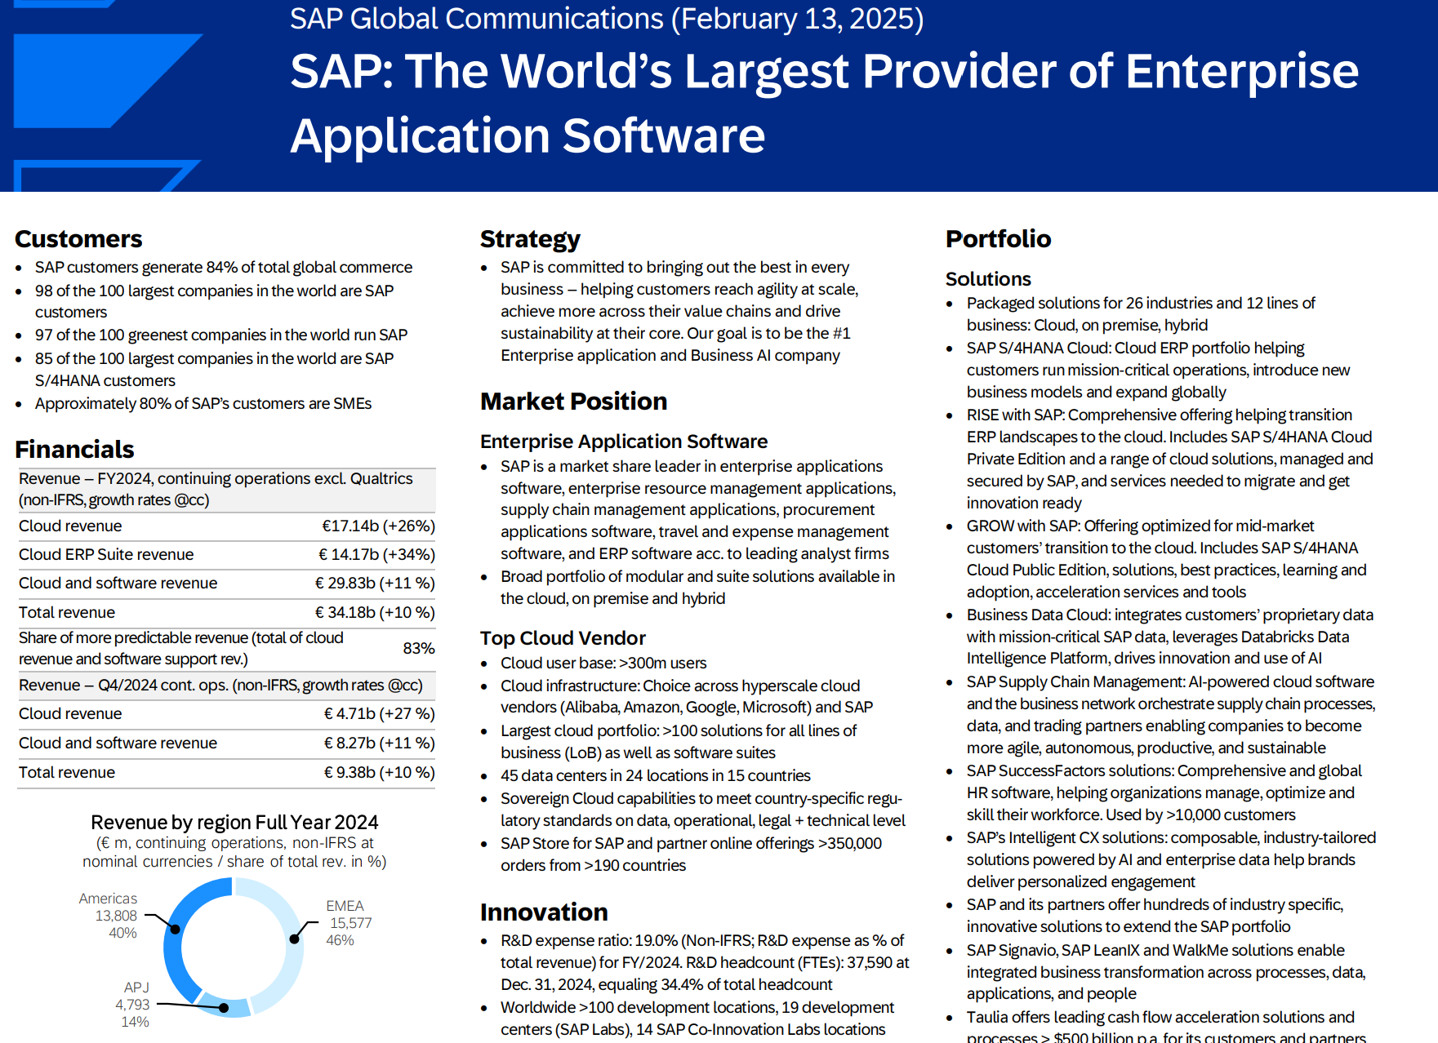
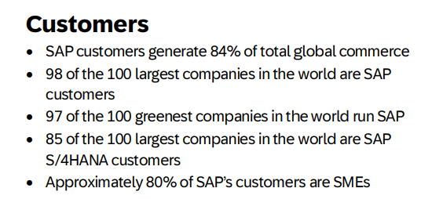
SAP Corporate Fact Sheet 2025
According to a March 2025 report from UN Trade and Development (UNCTAD), global trade in 2024 reached a record $33 trillion, a 3.7% increase from the previous year.
Origen was introduced by SAP, as the co-development partner for the SAP GTS product in Mexico and Brazil.
https://tac-insights.com/events/sap-for-global-trade-and-tax/sponsors-partners/
Notes:
Drag the image you want to place

Slide 6

Trends and Market Dynamics for International Trade Management
Market Dynamics
Challenges + Opportunities
Cost optimization has increased complexity in global supply chains, with lowest cost sources often exposing risks not visible until disruptions occur.
Recognize and assess potential exposure associated with supply shortages, tariffs and evolving trade regulations to proactively plan for mitigating strategies.
The growth of e-commerce has significantly expanded cross-border trade opportunities, allowing businesses of all sizes to reach global markets through online platforms.
Embrace digital technologies and automation within your operations to enhance efficiency, improve flexibility, and stay competitive in the ever-evolving market.
Ongoing negotiations and changes in trade agreements, as well as fluctuations in tariffs and trade tensions between nations, can impact the terms and conditions of international trade.
Efficiently manage and utilize Free Trade Agreements (FTAs), customs warehouses, Foreign Trade Zones (FTZs), and similar trade mechanisms to streamline operations and maximize benefits.
The regulatory landscape for international trade is evolving, potentially affecting market dynamics and trade practices.
Fulfill increasing compliance requirements associated with sanctions and tariffs, support new sustainability regulations impacting trade processes, and changes to customs procedures and rules
Rapid technological advancements and digitalization are transforming global trade processes, likely impacting market behaviors and trade strategies.
Leverage cloud technologies as a critical strategy to stay up-to-date with innovations like Artificial Intelligence (AI) and harness their potential for business growth and advancement.
6
6
Notes:
Cost optimization has increased complexity in global Supply Chain, but as a result organizations require the ability to assess and address inherent risks
There is an opportunity to embrace automation in order to enhance efficiency and help you stay competitive
This past year has been especially volatile in terms of tariffs and trade agreements… but organizations have an opportunity to address those challenges to some extent by utilizing Free Trade Agreements to streamline operations, and mitigate the impact of tariffs and social-political conditions.
The only guarantee in life is that there are no guarantees. The past few years have taught us is that the market is everchanging and unpredictable. SAP’s goal is… and has been … to put you in the best position to address the challenges to come and to capitalize on opportunities.

Slide 7




SAP Global Trade Services
GTS
SAP Global Trade Services
Customs Management
Compliance Management
Import & Export Management
Handle import/export customs, documentation, duties, and product classification, and optimize cost savings with trade strategies.
Ensure export/import compliance by checking transactions for embargoes, managing licenses, and using inline blocking/release for transactions.
Sanctioned Party Screening
Reporting
Free Trade Agreements
Trade Preference Management
Leverage free trade agreement benefits with automated product qualification, requesting supplier declarations, and issuance of customers declarations.
Sanctioned Party Screening
Enable screening for sanctioned parties across sales, procurement and finance operations, with automatic blocking and streamlined review through work lists and user-friendly workflow for escalated cases and authorization
Intrastat
Manage Intrastat declarations by providing statistical data in a country-specific format for intra-European trade between EU member states, submitted to the respective customs authority.
Notes:
talk to slide

Slide 8
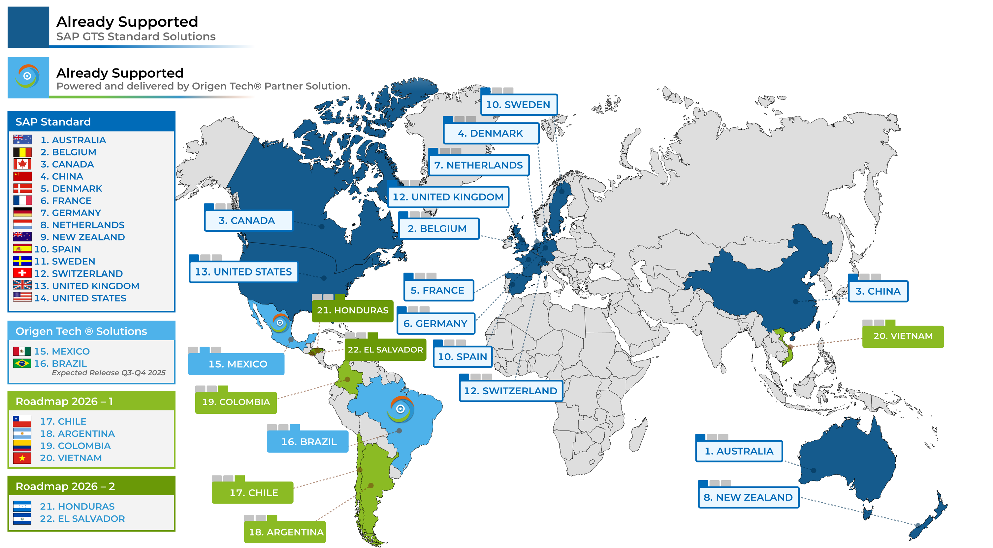
Our Services
SAP Global Trade Services
A development partner for SAP in Latin America, Central America, the Caribbean and Asia
Lead GTM Partner for SAP DRC​ Electronic Invoicing Solutions​
Partnership with Synchro (Brazil), the largest fiscal solutions provider, delivering integration with SAP DRC and Synchro
100+ Strong DEVOPS team​ For Product Development and Innovation​
100+ countries requiring electronic document submissions to governments
Our extensive and unique IP across several countries allows ours Multinational Clients to adopt SAP Tax & Trade standard SAP Platforms to run globally

Slide 9




Existing International Trade Management Landscape… Often lacks flexibility, scalability, and automation
With SAP International Trade Management
Establish a central platform for…
Lack of Automation and Integration: Manual processes and disconnected systems lead to inefficiencies and errors in trade operations.
Automated Trade Processes: Streamlined and automated compliance, documentation, and reporting for efficient trade operations.
Limited Visibility and Awareness: Inadequate information to identify existing problems or opportunities for improvement.
Enhanced Analytics and Reporting: Leverage embedded analytics and reporting to proactively manage wide-ranging operations.
Complex Documentation and Communication: Complicated paperwork and disjointed communication methods hinder smooth trade transactions.
Efficient Documentation and Communication: Simplified documentation and centralized communication for seamless trade interactions.
Limited User Management: Inadequate tools to manage system access.
Robust Risk Management and Security: Advanced tools to identify, assess, and manage trade-related risks with strengthened data security measures.
Inconsistent Processes and Compliance: Variety of solutions used by country or region with no consistent compliance.
Single Global Solution: Solution to support operations around the globe, assuring consistency while able to meet country-specific requirements.
Notes:
The goal with our international trade portfolio is to create a central platform that has… talk through…

Slide 10



Fueling our growth Establishing a Global SAP University Alliance Partnership I SAP AppHause around Compliance
Academic innovation through SAP collaborations with Origen Tech
Empowering future SAP talent with
SAP Compliance, Tax & Trade as a key focus area
Bridging academia and industry by connecting students, partners, and businesses
Trainee and employee
onboarding into Origen Tech
Expanding Academic Partnerships​. ​
Working with SAP Leadership to expand to additional focus areas​

Slide 11

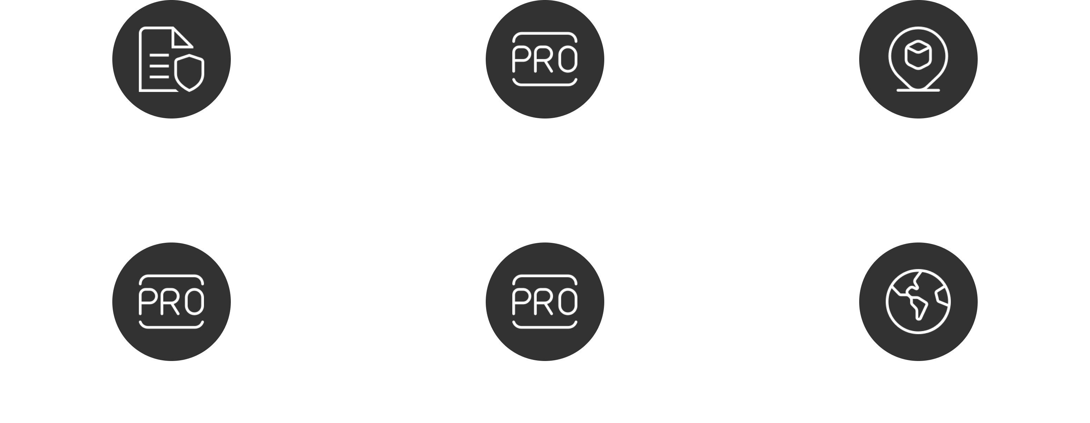
Why Origen Tech
Trusted SAP Compliance and Localization Partner ​
Global Tax & Trade Experts​
Nearshore Delivery Hubs​ ​
Experienced Multilingual
SAP Experts
SAP VAR Gold, Product Development, & Consulting Partner ​
SAP Co-Innovation

Slide 12


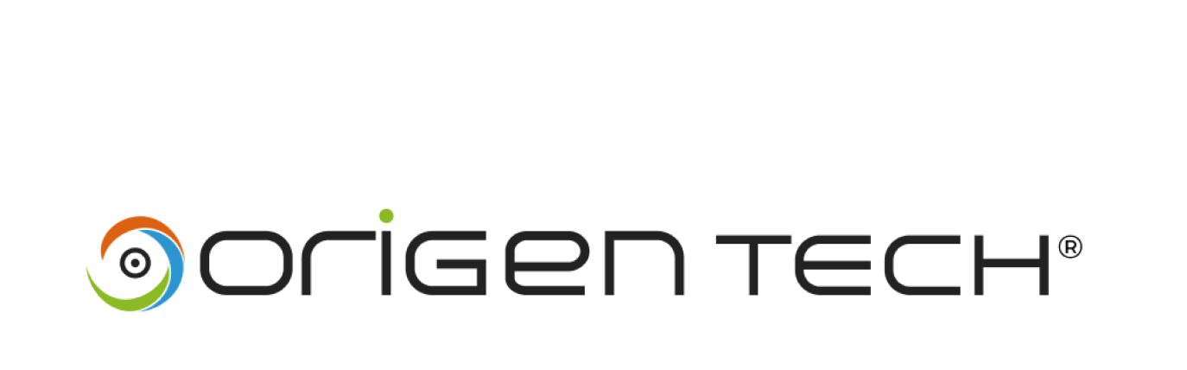
Thank You

