Slide 1
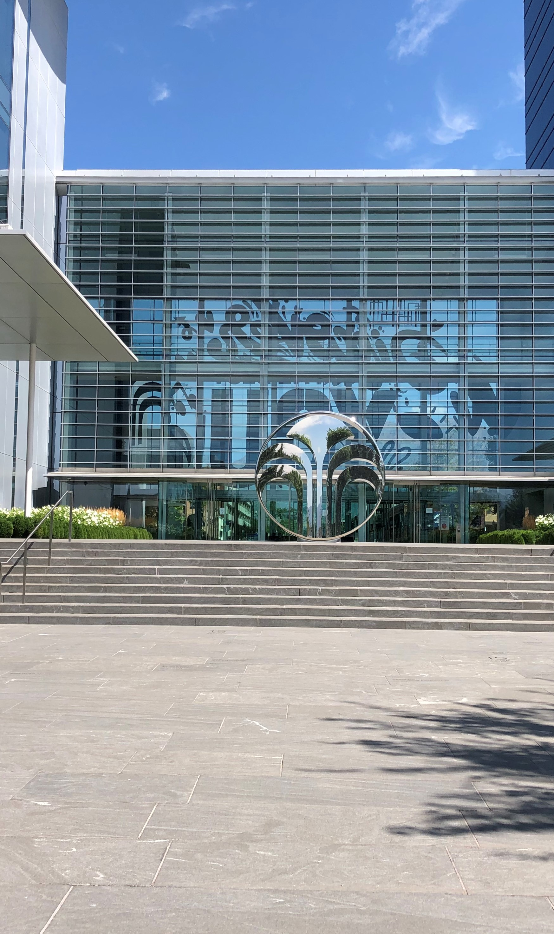


Nu Skin – Using the extensibility option of SAP Document and Reporting Compliance for Vietnam
Nu Skin is using SAP Document and Reporting Compliance for electronic invoicing in Mexico and Peru. When the General Department of Taxation in Vietnam announced the mandatory use of electronic invoicing, Nu Skin collaborated with Origen Technologies to extend Document and Reporting Compliance for Vietnam in the time and manner required by local regulation in 2022.
Nu Skin Enterprises is an American multilevel marketing company that develops and sells personal care products and dietary supplements under its Nu Skin and Pharmanex brands. The company originated in the United States and began its first foreign operation in Canada in 1990. The company markets its products in 54 markets through a network of approximately 1.2 million independent distributors.
Origen Technologies is a global consulting firm with more than a decade of experience in business processes, digital transformation, and SAP systems integration as well as extensive knowledge in tax compliance solutions for multinational companies with its e-invoicing, tax reporting, and localization projects in Latin America and Brazil. Strong collaboration with SAP on Document and Reporting Compliance has allowed for product extensibility for new countries to run them in compliance with regulations.
Picture Credit | Nu Skin, Provo, United States. Used with permission.

Slide 2
Nu Skin using e-invoices and receiving process at the Walk-in center.
“We like automatization”, By adopting SAP Document and Reporting Compliance for Vietnam and using the features available in the cockpit, all our electronic invoices are sent electronically direct to our customers, eliminating manual processing.”
Terry Blackwell, Mgr. Business Integration, Nu Skin Enterprises.
Nu Skin Vietnam has two walk in centers, one in Hanoi and one in Ho Chi Minh City. Customers send orders through the Nu Skin website, then come to the walk-in centers to pick up their products while the electronic invoice is generated.
Before: Challenges and opportunities
Enable to comply with e-invoice mandates for Vietnam.
After e-invoice implementation: value drive results
Meet implementation deadline of July 1st, 2022.
Achieved compliance with General Department of Taxation regulation of Vietnam.
Since the use of e-invoices Nu Skin Vietnam has informed to Brand Affiliate and Prefer Customer that Nu Skin Company guarantees to send an e-Invoice to the registered email address in the name of the purchase invoice for all forms of order (at the counter or online) as soon as the order is completed payment.
Therefore, Nu Skin's Brand Affiliate and Prefer Customer use this e-Invoice to receive the goods at the Nu Skin distribution center increasing transparency and automatization of the electronic invoice process
Featured Partner
PUBLIC | xxxxxenUS (YY/MM) © 2022 SAP SE or an SAP affiliate company. sap.com/terms-of-use
Nu Skin Vietnam
75 W Center Street
Provo, UT 84601 www.nuskin.com
Industry
Direct Sales.
Products and Services
Personal care and wellness products
Employees
Approximate 1500 of employees
Featured Solutions and Services
SAP S/4HANA
SAP Document and Reporting Compliance

Slide 3
Nu Skin automatized its electronic invoice management processes to enable efficiency, security and flexibility.
“A real team effort”, By taking the challenge of extending Document and Reporting Compliance for Vietnam and working together as unique team between the Consulting team of Origen, IT BA of Nu Skin and the local third partly integrator were able to complete the project in the time and manner required by local regulation to start issuing electronic invoices starting in July 2022.”
Gustavo Colamussi, SAP LATAM Localization Mgr., Origen Technologies
About and Why Vietnam electronic invoice solution in SAP
Automated and real-time end-to-end communication between SAP S/4HANA and Vietnam third party integrator.
Through SAP Integration Suite the third-party local integrator will receive, validate, and approve electronic invoices on behalf of the General Department of Taxation (GDT) of Vietnam.
Once the electronic invoices are approved, the approval authorization electronic code (CQT code) returns to SAP and updates the electronic invoice cockpit / monitor within SAP Document and Reporting Compliance, Once the approval status is updated the electronic invoice is send automatically by e-mail to the recipient.
Using the rapid extensibility option for SAP Document and Reporting Compliance, electronic invoice for Vietnam is a partner transparent solution following the same architecture as other standard country Document and Reporting Compliance solution offerings.
Featured Partner
PUBLIC | xxxxxenUS (YY/MM) © 2022 SAP SE or an SAP affiliate company. sap.com/terms-of-use
Nu Skin Vietnam
75 W Center Street
Provo, UT 84601 www.nuskin.com
Industry
Direct Sales.
Products and Services
Cosmetics, beauty devices, nutritional products
Employees
Approximate 1500 of employees
Featured Solutions and Services
SAP S/4HANA
SAP Document and Reporting Compliance

